Slide 1
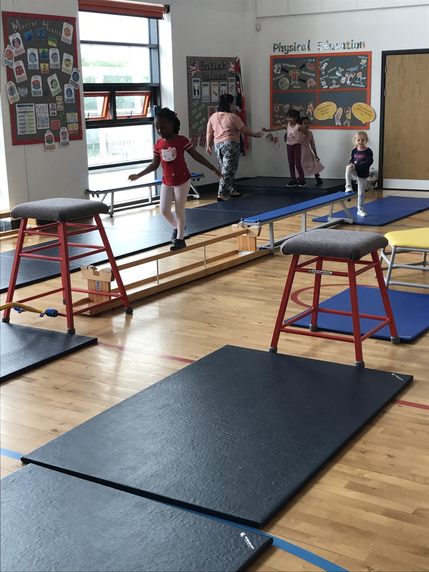
PE Update

Slide 2
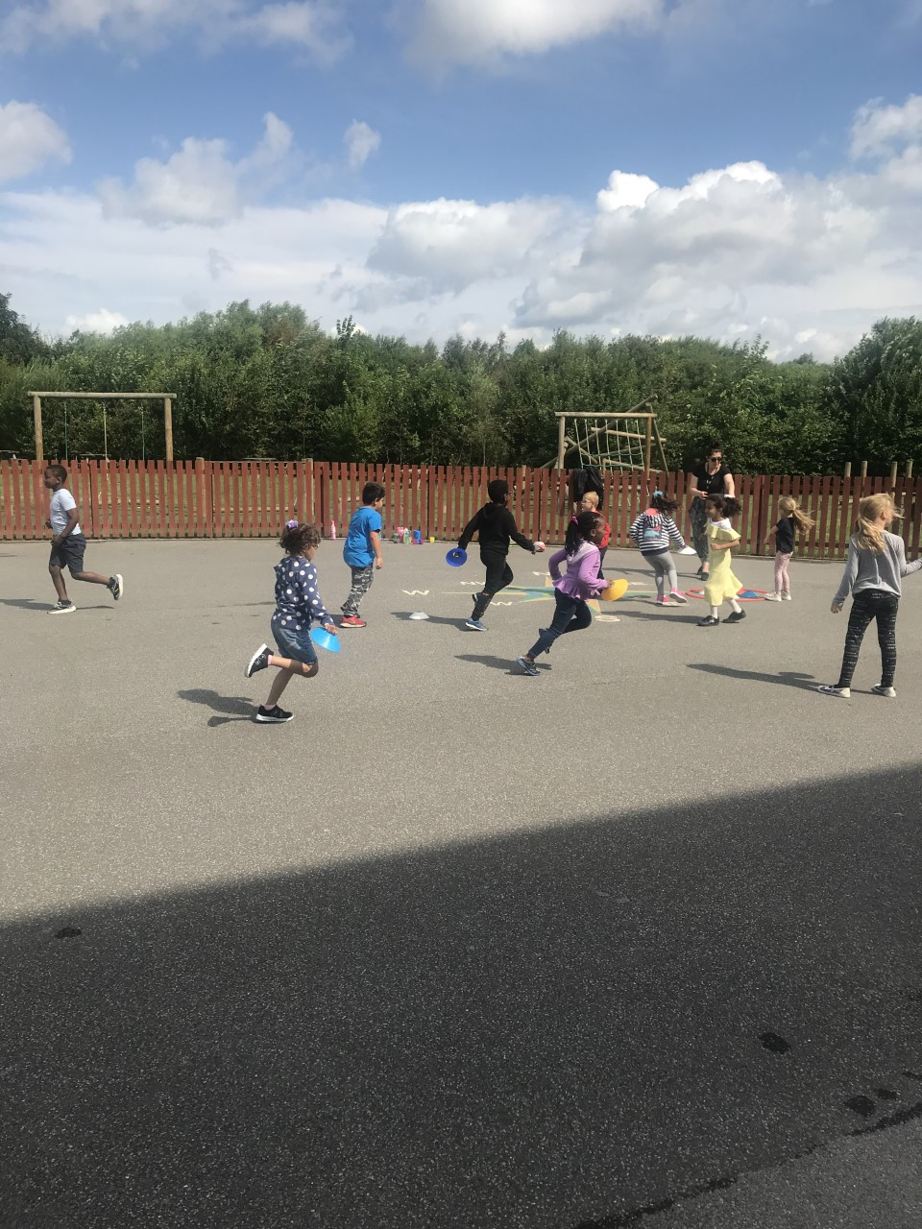
NC & EYFS
Develop competence to excel in a broad range of physical activities
Ensure children are physically active for sustained periods of time
Ensure children engage in competitive sports and activities
Ensure children lead healthy, active lives
Foundation Stage

Slide 3
KS1 NC
Pupils should be taught to
master basic movements including running, jumping, throwing and catching, as well as developing balance, agility and co-ordination, and begin to apply these in a range of activities
▪ participate in team games, developing simple tactics for attacking and defending
▪ perform dances using simple movement patterns.

Slide 4
KS2 NC
Pupils should be taught to:
▪ use running, jumping, throwing and catching in isolation and in combination
▪ play competitive games, modified where appropriate, such as badminton, basketball, cricket, football, hockey, netball, rounders and tennis, and apply basic principles suitable for attacking and defending
▪ develop flexibility, strength, technique, control and balance, for example through athletics and gymnastics
▪ perform dances using a range of movement patterns
▪ take part in outdoor and adventurous activity challenges both individually and within a team
▪ compare their performances with previous ones and demonstrate improvement to achieve their personal best.

Slide 5
Disciplines
FS- Creative and expressive arts/ Physical skills
KS1 Games, Gym & Dance
KS2 As KS1 with Athletic Education and Outdoor and Adventurous Education (OAA)
Swimming taught at least once and in at least one Key Stage

Slide 6

SOW & LTP
Gymnastics Planner
 | Autumn 1 | Autumn 2 | Spring 1 | Spring 2 | Summer 1 | Summer 2
Foundation Stage | Intro to Gym Skills Unit 1 | Travelling |  | Stretching and curling | Travelling taking weight on Different body parts
Year 1 | Flight | Points and patches |  | Rocking and rolling |  | Wide narrow curled
Year 2 | Parts high and parts low |  | Pathways Zig zag/ curved | Spinning, turning and twisting |  | Linking movements together
Year 3 | Stretching, curling & arching |  | Symmetry and | Asymmetry | Pathways 2 | Travelling with change of front and direction
Year 4 | Balance |  | Receiving body | weight | Balance leading into change of front and direction | Rolling
Year 5 | Bridges |  | Flight |  | Functional use of arms | Spinning and turning
Year 6 | Matching and mirroring and contrasting |  | Synchronisation and canon |  | Holes and barriers | Counter balance and counter tension

Slide 7
Timetable & expectations
2 hour entitlement
2 Timetabled lessons per week
Indoor- Gym or Dance
Outdoor – Games/ OAA or Athletics

Slide 8
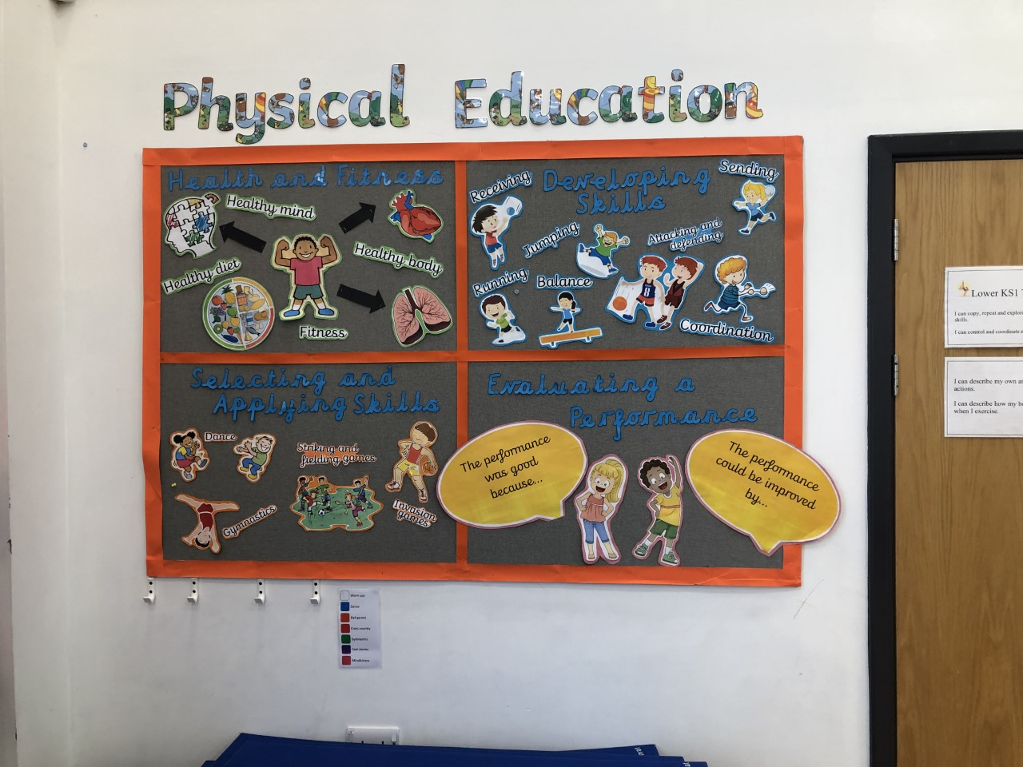
Lesson Format
Instant Activity- to promote and develop knowledge & understanding of fitness and health (K&U of F&H) Follow my leader/ dance track
Acquiring & Developing skills ( K&U of F&H)
Selecting & applying skills
Evaluating & Improving performance
Use the displays

Slide 9
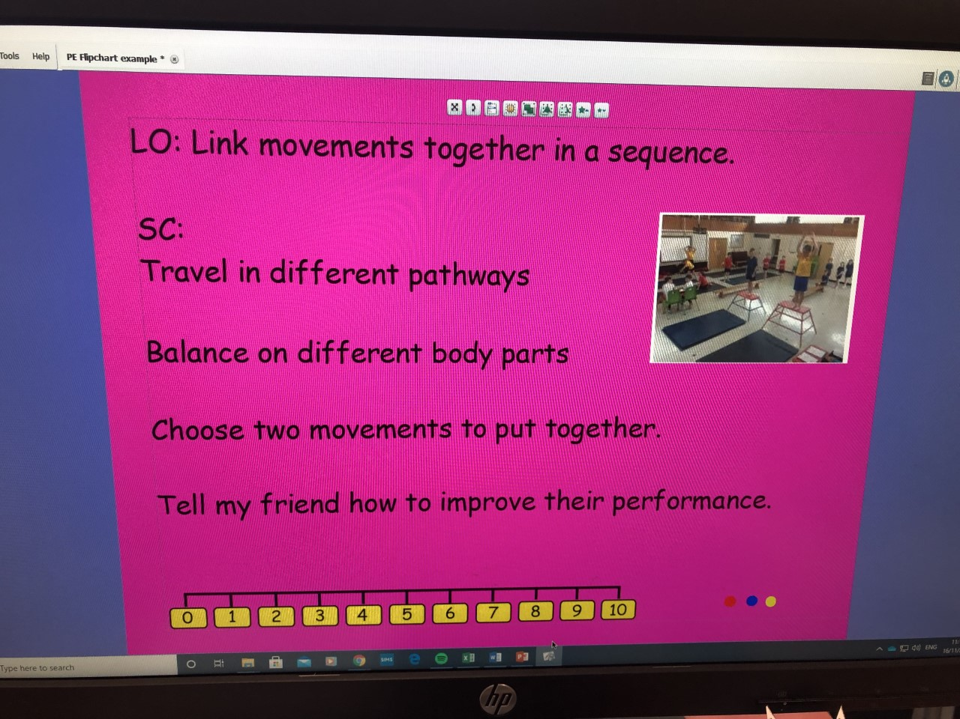
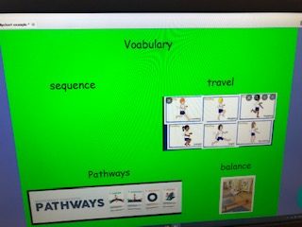
Start with a flip chart
See models presented.
How to construct
Page 1 LO & SC & Self assessment scale.
Page 2 Vocabulary
Page 3 Evaluating & Improving performance
Page 4 Video Clip of what is expected or pupil’s work. Please note. Video could be used after vocabulary introduction too.
Once built this will only need tiny tweaks for a series of lessons.

Slide 10
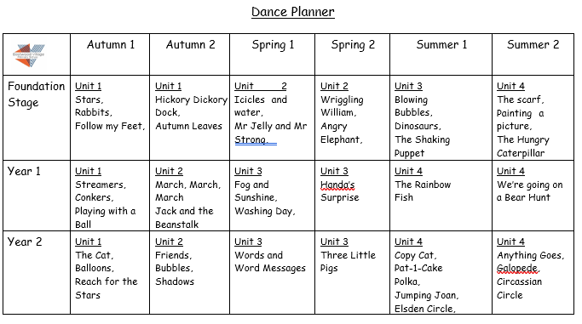
Using The SOW purposefully
Go back to NC expectations.
Fit around themes- especially Dance which is cross curricular.
Cover all areas. Games Gym & Dance

Slide 11
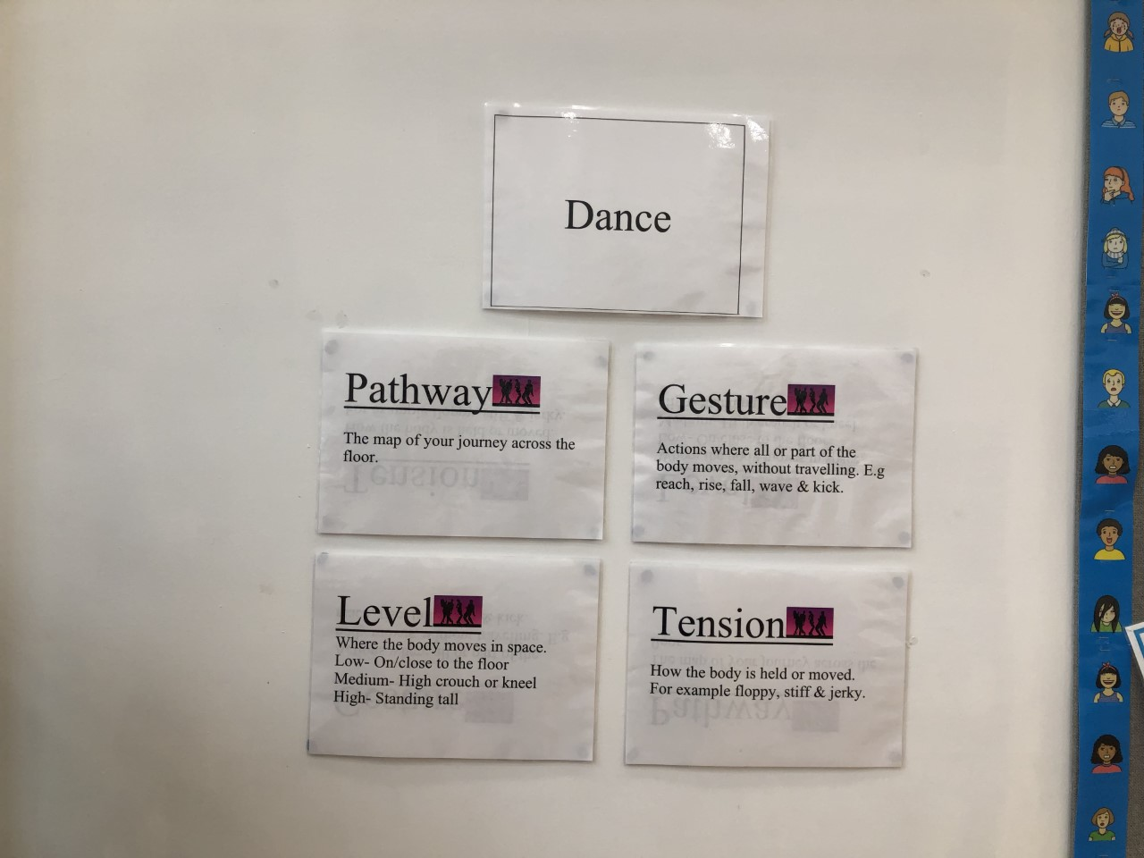
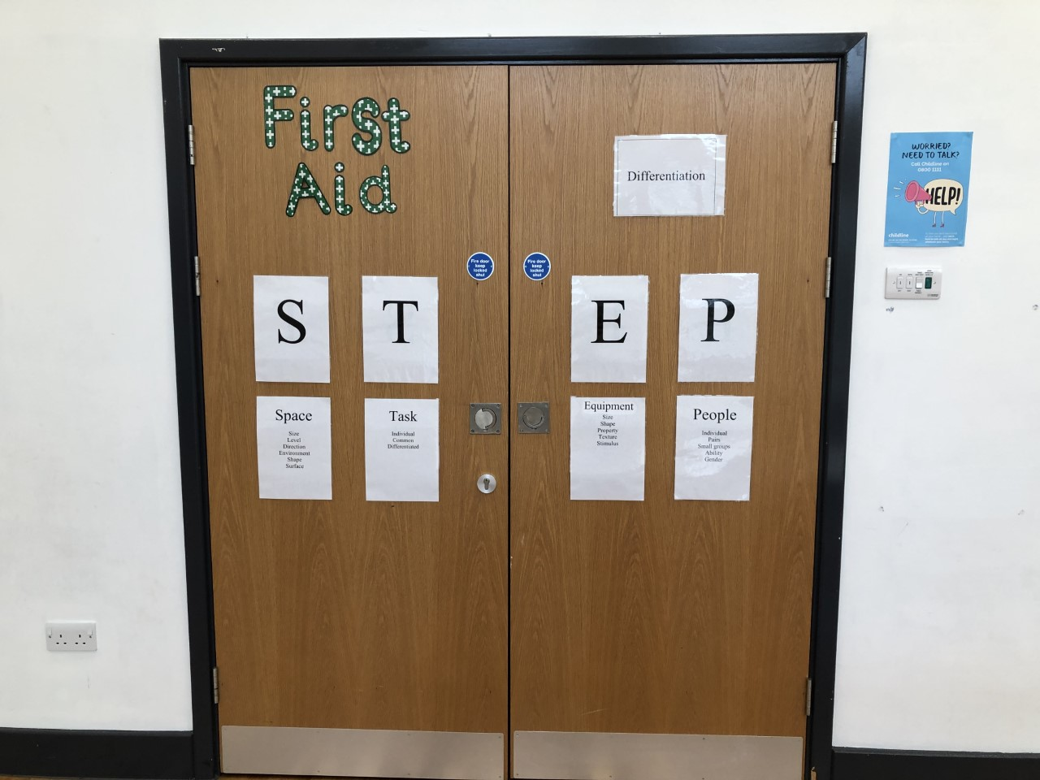
Using the displays purposefully
Teaching a lesson from the displays.- Specialist teacher
Use Assessment criteria to support pupil evaluation.
Differentiation
Follow/ prompt teaching sequence

Slide 12
Useful info for lesson delivery
Less is more. Use Val Sabin Scheme. Expect to get 3 lessons out of 1.
Quality not quantity- build on pupil’s ideas. Use pupil demonstrations to direct new teaching. Practise new teaching. Evaluate performance and refine/ improve.
Multiple access points to equipment for ease of distribution.
Group before hand.

Slide 13
Assessment
Views of what is being used already.
Use criteria grid to create a representation of the class- Gifted, Higher, Middle, Lower attainers.
Map pupils to this best fit representation.
Use the criteria grid statements to support report writing and cdefining children’s next steps.

