Slide 1
Y1 learning resources
Eastwood Village Primary school

Slide 2




Y1 reading list
Peace at last
Can’t you sleep little bear
Where the wild things are
The elephant and the baby elephant
Avocado baby
The tiger who came to tea
Lost and found
Knuffle bunny
Beegu
Dogger, Cops and robbers
Elmer

Slide 3
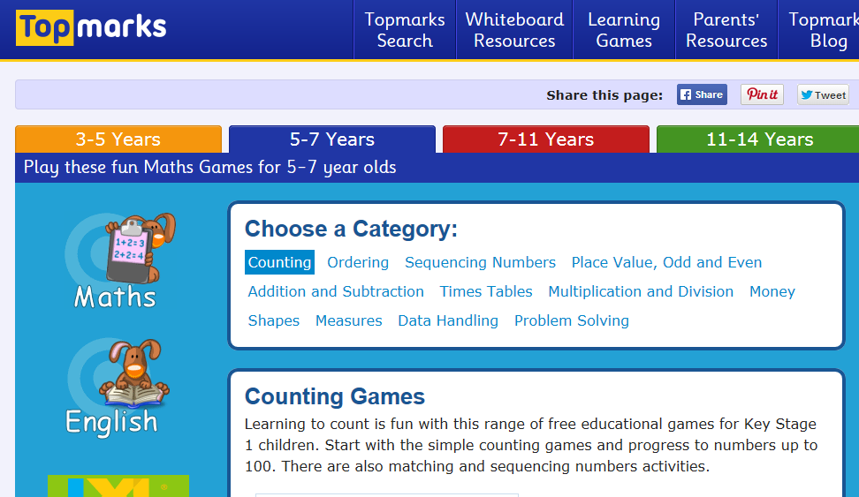
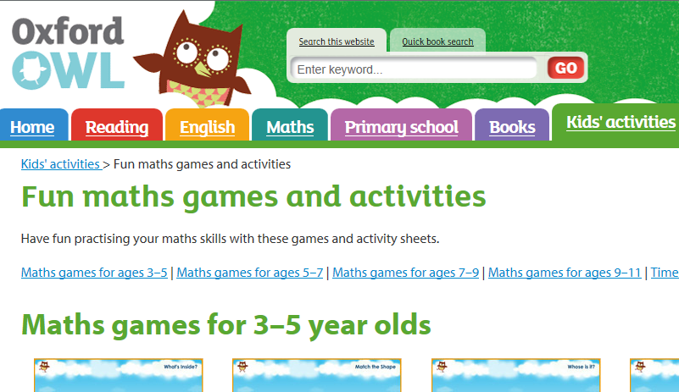
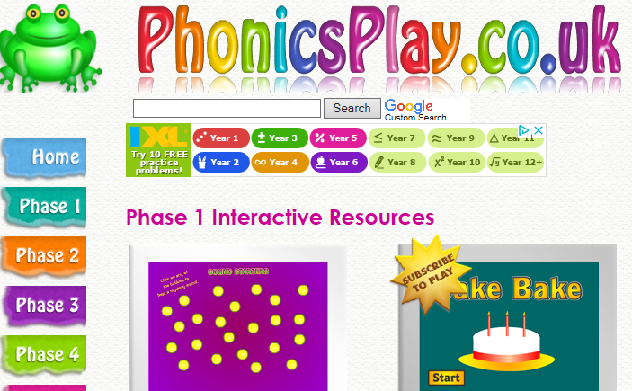
Website links for games
https://www.topmarks.co.uk/maths-games/5-7-years/counting
https://www.phonicsplay.co.uk/Phase1Menu.htm
https://www.oxfordowl.co.uk/for-home/kids-activities/fun-maths-games-and-activities/

