Slide 1
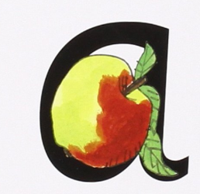

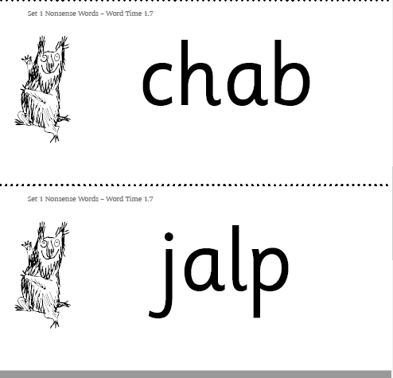


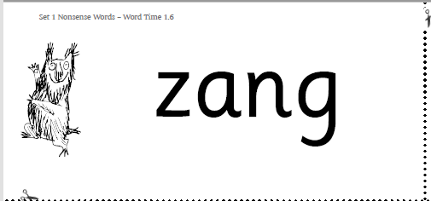
Phonics Homework Please practice saying the sound and reading the real and alien words. Ask your child to look for ‘special friends’ and to ‘Fred Talk’
Real Words
cat
at
mat
pat
Alien Words

Slide 2
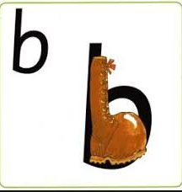

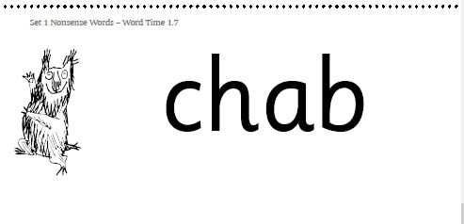
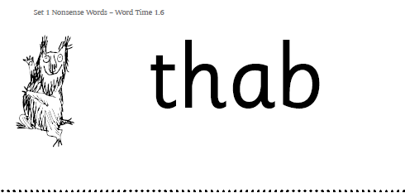

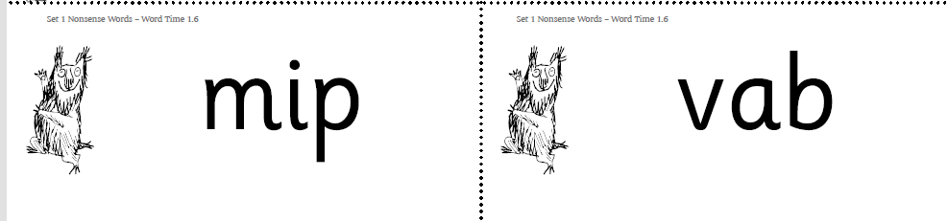
Phonics Homework Please practice saying the sound and reading the real and alien words. Ask your child to look for ‘special friends’ and to ‘Fred Talk’
Real Words
bat
bed
bin
bat
Alien Words

Slide 3
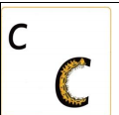
Phonics Homework Please practice saying the sound and reading the real and alien words. Ask your child to look for ‘special friends’ and to ‘Fred Talk’
Real Words
cat
cut
act
cot
Alien Words
cug
coj
ced
ruc
cul
nuc

Slide 4
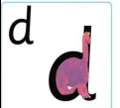
Phonics Homework Please practice saying the sound and reading the real and alien words. Ask your child to look for ‘special friends’ and to ‘Fred Talk’
Real Words
dad
dam
add
dip
Alien Words
doz deb
fud dup
mid gid

Slide 5
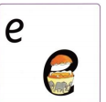
Phonics Homework Please practice saying the sound and reading the real and alien words. Ask your child to look for ‘special friends’ and to ‘Fred Talk’
Real Words
egg
end
pet
bed
Alien Words
epp theg
ped deg
ged eng

Slide 6
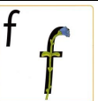
Phonics Homework Please practice saying the sound and reading the real and alien words. Ask your child to look for ‘special friends’ and to ‘Fred Talk’
Real Words
fat
elf
fit
fox
Alien Words
fesh fust
reft feng
dift geft

Slide 7
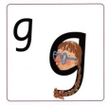
Phonics Homework Please practice saying the sound and reading the real and alien words. Ask your child to look for ‘special friends’ and to ‘Fred Talk’
Real Words
get
egg
beg
leg
Alien Words
ged theg
cheg guch
deng gid

Slide 8
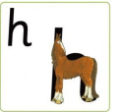
Phonics Homework Please practice saying the sound and reading the real and alien words. Ask your child to look for ‘special friends’ and to ‘Fred Talk’
Real Words
hat
hop
hen
ham
Alien Words
hent hup
hesp hety
Mid hesh

Slide 9
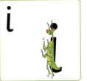
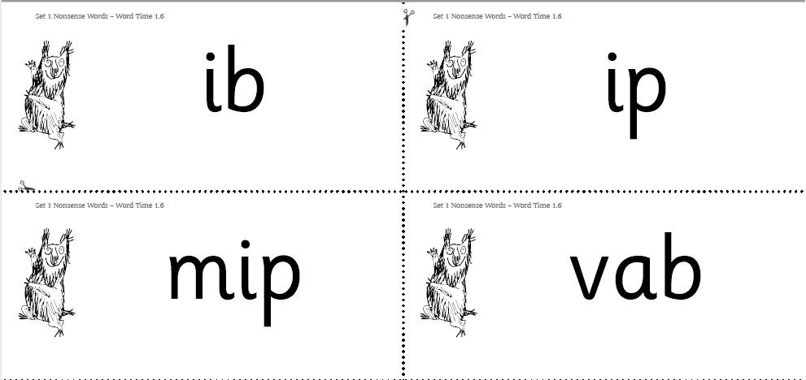
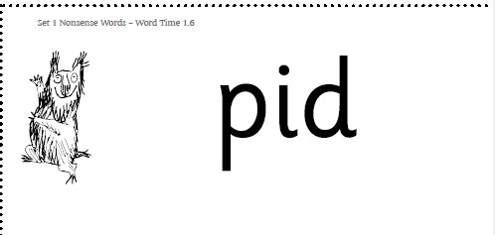
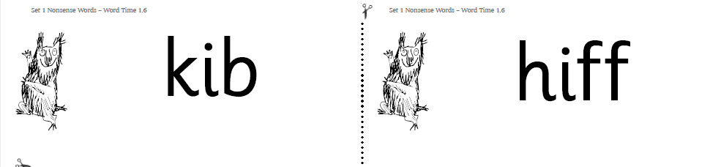
Phonics Homework Please practice saying the sound and reading the real and alien words. Ask your child to look for ‘special friends’ and to ‘Fred Talk’
Real Words
ink
it
imp
hit
Alien Words

Slide 10
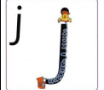
Phonics Homework Please practice saying the sound and reading the real and alien words. Ask your child to look for ‘special friends’ and to ‘Fred Talk’
Real Words
jam
jot
jim
jug
Alien Words
jed jush
jud jis
jelp jat

Slide 11
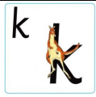
Phonics Homework Please practice saying the sound and reading the real and alien words. Ask your child to look for ‘special friends’ and to ‘Fred Talk’
Real Words
kin
kit
ken
kick
Alien Words
kest kud
hek klup
keth kech

Slide 12
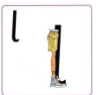
Phonics Homework Please practice saying the sound and reading the real and alien words. Ask your child to look for ‘special friends’ and to ‘Fred Talk’
Real Words
leg
log
lid
lap
Alien Words
losh lod
chult duls
sild guld

Slide 13

Phonics Homework Please practice saying the sound and reading the real and alien words. Ask your child to look for ‘special friends’ and to ‘Fred Talk’
Real Words
mat
mop
mom
mud
Alien Words
milg thom
chal dums
mid gims

Slide 14
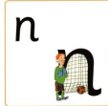
Phonics Homework Please practice saying the sound and reading the real and alien words. Ask your child to look for ‘special friends’ and to ‘Fred Talk’
Real Words
net
nap
hen
ben
Alien Words
neds nodm
wun dunp
nept gind

Slide 15
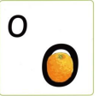
Phonics Homework Please practice saying the sound and reading the real and alien words. Ask your child to look for ‘special friends’ and to ‘Fred Talk’
Real Words
log
dog
hog
odd
Alien Words
dosh thod
chom dosh
mod sond

Slide 16
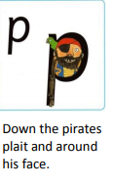
Phonics Homework Please practice saying the sound and reading the real and alien words. Ask your child to look for ‘special friends’ and to ‘Fred Talk’
Real Words
peg
pot
hop
pen
Alien Words
posh pont
nopt dopn
sop gipt

Slide 17
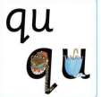
Phonics Homework Please practice saying the sound and reading the real and alien words. Ask your child to look for ‘special friends’ and to ‘Fred Talk’
Real Words
quick
quiz
queen
quack
Alien Words
quint quet
quont quosh
quins queet

Slide 18
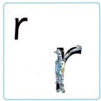
Phonics Homework Please practice saying the sound and reading the real and alien words. Ask your child to look for ‘special friends’ and to ‘Fred Talk’
Real Words
rat
run
rip
rob
Alien Words
rosh thort
chur dun
mer grut

Slide 19
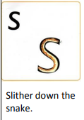
Phonics Homework Please practice saying the sound and reading the real and alien words. Ask your child to look for ‘special friends’ and to ‘Fred Talk’
Real Words
sat
sin
sun
bus
Alien Words
dosh thod
chud dush
mid gid

Slide 20
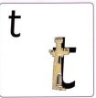
Phonics Homework Please practice saying the sound and reading the real and alien words. Ask your child to look for ‘special friends’ and to ‘Fred Talk’
Real Words
tom
ten
ten
bat
Alien Words
tods tund
sunt dunt
mita fotn

Slide 21
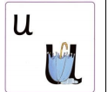
Phonics Homework Please practice saying the sound and reading the real and alien words. Ask your child to look for ‘special friends’ and to ‘Fred Talk’
Real Words
tum
up
bun
cup
Alien Words
dush nuch
chud buv
kug puc

Slide 22
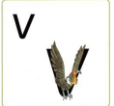
Phonics Homework Please practice saying the sound and reading the real and alien words. Ask your child to look for ‘special friends’ and to ‘Fred Talk’
Real Words
van
vat
vet
Alien Words
vush vod
vong cov
vud vash

Slide 23
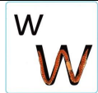
Phonics Homework Please practice saying the sound and reading the real and alien words. Ask your child to look for ‘special friends’ and to ‘Fred Talk’
Real Words
wig
win
wag
web
Alien Words
wanch woz
wuck wunk
wik wid

Slide 24
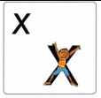
Phonics Homework Please practice saying the sound and reading the real and alien words. Ask your child to look for ‘special friends’ and to ‘Fred Talk’
Real Words
box
mix
fix
six
Alien Words
dox thux
chux dex
dix chex

Slide 25
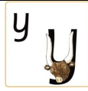
Phonics Homework Please practice saying the sound and reading the real and alien words. Ask your child to look for ‘special friends’ and to ‘Fred Talk’
Real Words
yam
yet
yes
yet
Alien Words
yosh thuy
yelm yush
yid yex

Slide 26
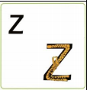
Phonics Homework Please practice saying the sound and reading the real and alien words. Ask your child to look for ‘special friends’ and to ‘Fred Talk’
Real Words
zen
zip
zap
zit
Alien Words
coz choz
dez zuck
mizd gizt

Slide 27

Phonics Homework Please practice saying the sound and reading the real and alien words. Ask your child to look for ‘special friends’ and to ‘Fred Talk’
Real Words
chop
chip
check
bench
Alien Words
doch chod
chud luch
mich gich

Slide 28

Phonics Homework Please practice saying the sound and reading the real and alien words. Ask your child to look for ‘special friends’ and to ‘Fred Talk’
Real Words
that
this
bath
moth
Alien Words
thosh thod
thuch duth
thid gith

Slide 29

Phonics Homework Please practice saying the sound and reading the real and alien words. Ask your child to look for ‘special friends’ and to ‘Fred Talk’
Real Words
thing sink
sing drink
ping link
song bunk
Alien Words
thung thonk
gung denk
hing gink

