Slide 1

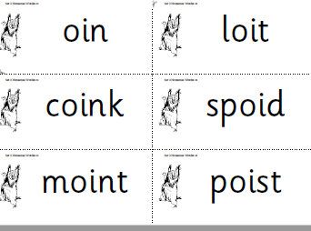
Phonics Homework
Please practice saying the sound and reading the real and alien words. Ask your child to look for ‘special friends’ and to ‘Fred Talk’
Real Words
coin
spoil
foil
boil
Alien Words

Slide 2
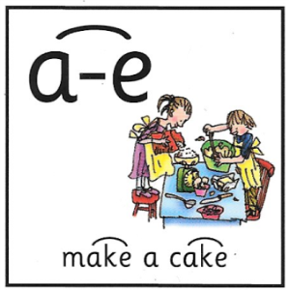
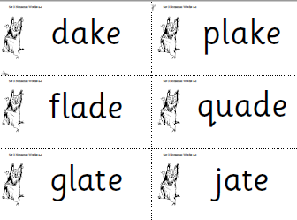
Phonics Homework
Please practice saying the sound and reading the real and alien words. Ask your child to look for ‘special friends’ and to ‘Fred Talk’
Real Words
bake
shake
flake
cake
Alien Words

Slide 3

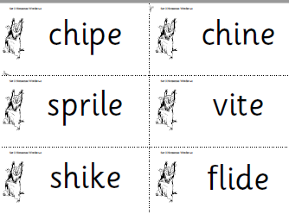
Phonics Homework
Please practice saying the sound and reading the real and alien words. Ask your child to look for ‘special friends’ and to ‘Fred Talk’
Real Words
spice
slice
nice
like
Alien Words

Slide 4
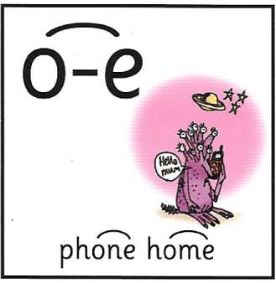
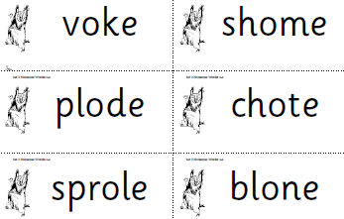
Phonics Homework
Please practice saying the sound and reading the real and alien words. Ask your child to look for ‘special friends’ and to ‘Fred Talk’
Real Words
bone
alone
home
tone
Alien Words

Slide 5

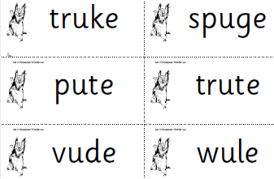
Phonics Homework
Please practice saying the sound and reading the real and alien words. Ask your child to look for ‘special friends’ and to ‘Fred Talk’
Real Words
flute
cube
tube
cute
Alien Words

Slide 6

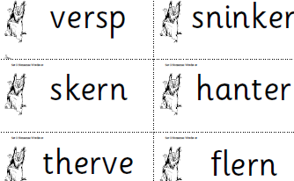
Phonics Homework
Please practice saying the sound and reading the real and alien words. Ask your child to look for ‘special friends’ and to ‘Fred Talk’
Real Words
her
over
never
after
Alien Words

Slide 7

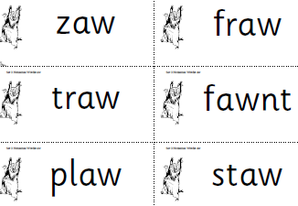
Phonics Homework
Please practice saying the sound and reading the real and alien words. Ask your child to look for ‘special friends’ and to ‘Fred Talk’
Real Words
saw
yawn
law
crawl
Alien Words

Slide 8

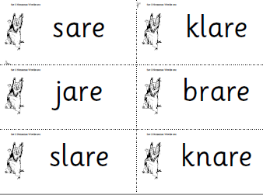
Phonics Homework
Please practice saying the sound and reading the real and alien words. Ask your child to look for ‘special friends’ and to ‘Fred Talk’
Real Words
care
share
dare
square
Alien Words

Slide 9
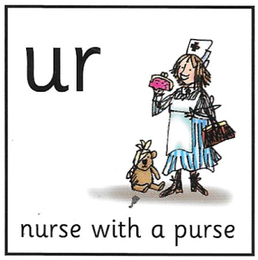
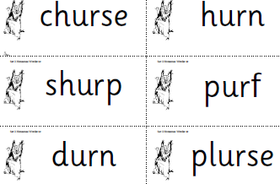
Phonics Homework
Please practice saying the sound and reading the real and alien words. Ask your child to look for ‘special friends’ and to ‘Fred Talk’
Real Words
coin
spoil
foil
boil
Alien Words

Slide 10
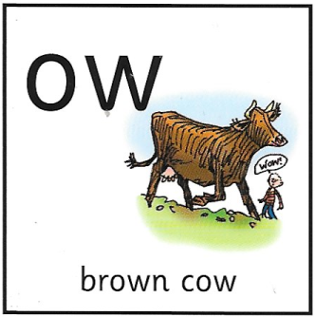
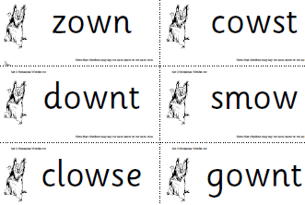
Phonics Homework
Please practice saying the sound and reading the real and alien words. Ask your child to look for ‘special friends’ and to ‘Fred Talk’
Real Words
crowd
down
howl
town
Alien Words

Slide 11
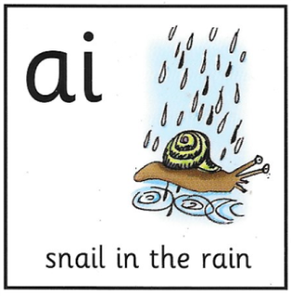
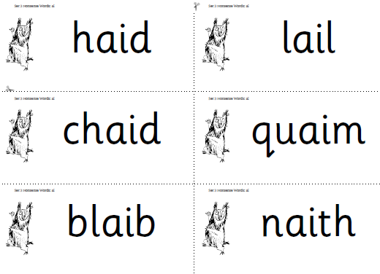
Phonics Homework
Please practice saying the sound and reading the real and alien words. Ask your child to look for ‘special friends’ and to ‘Fred Talk’
Real Words
paid
train
chain
drain
Alien Words

Slide 12
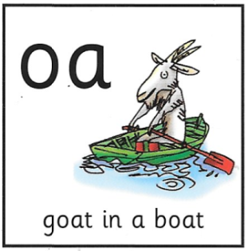
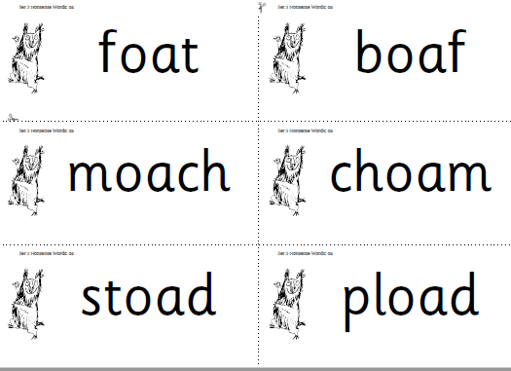
Phonics Homework
Please practice saying the sound and reading the real and alien words. Ask your child to look for ‘special friends’ and to ‘Fred Talk’
Real Words
float
toad
throat
toast
Alien Words

Slide 13
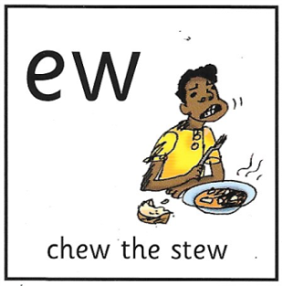
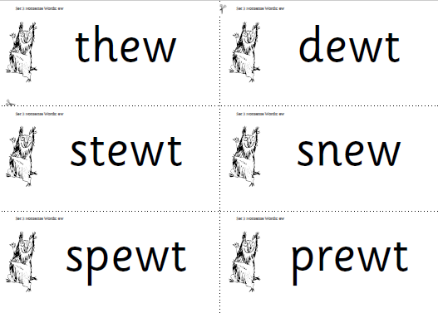
Phonics Homework
Please practice saying the sound and reading the real and alien words. Ask your child to look for ‘special friends’ and to ‘Fred Talk’
Real Words
crew
newt
flew
screw
Alien Words

Slide 14

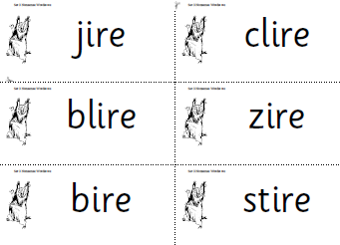
Phonics Homework
Please practice saying the sound and reading the real and alien words. Ask your child to look for ‘special friends’ and to ‘Fred Talk’
Real Words
fire
tire
wire
hire
Alien Words

Slide 15

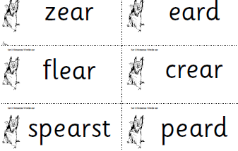
Phonics Homework
Please practice saying the sound and reading the real and alien words. Ask your child to look for ‘special friends’ and to ‘Fred Talk’
Real Words
year
hear
near
tear
Alien Words

Slide 16

Phonics Homework
Please practice saying the sound and reading the real and alien words. Ask your child to look for ‘special friends’ and to ‘Fred Talk’
Real Words
sure
pure
cure
Alien Words
mure
ranure
chure
flure
plure
jure

Slide 17

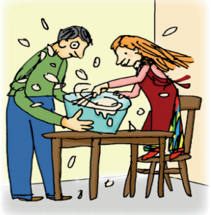
Phonics Homework
Please practice saying the sound and reading the real and alien words. Ask your child to look for ‘special friends’ and to ‘Fred Talk’
Real Words
when
whisk
which
wheel
whisk whisk
Alien Words
whazz
whedz
whime
whalp
whape
whuck

Slide 18
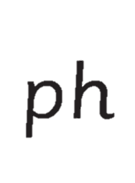

Phonics Homework
Please practice saying the sound and reading the real and alien words. Ask your child to look for ‘special friends’ and to ‘Fred Talk’
Real Words
phone
morph
phase
graph
take a photo
Alien Words
phip
chorph
phads
phile
scraph
phelks

Slide 19

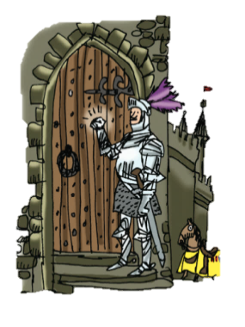
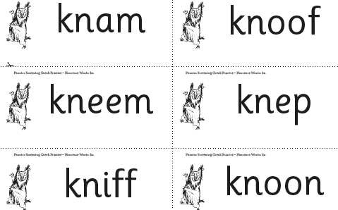
Phonics Homework
Please practice saying the sound and reading the real and alien words. Ask your child to look for ‘special friends’ and to ‘Fred Talk’
Real Words
know
knot
knee
knight
Knock knock
Alien Words

Slide 20

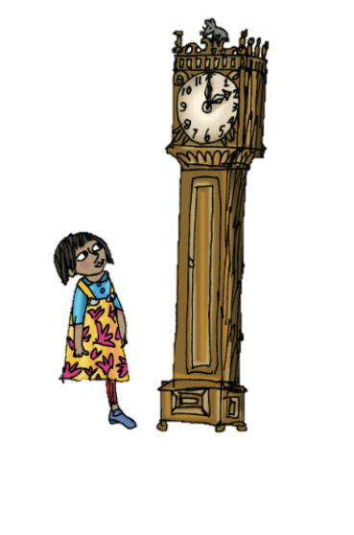
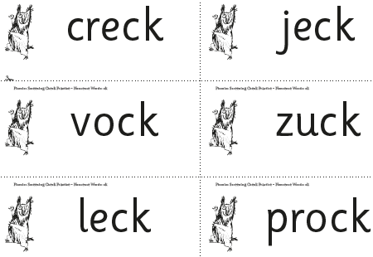
Phonics Homework
Please practice saying the sound and reading the real and alien words. Ask your child to look for ‘special friends’ and to ‘Fred Talk’
Real Words
shock
duck
click
check
Tick tock clock
Alien Words

Slide 21

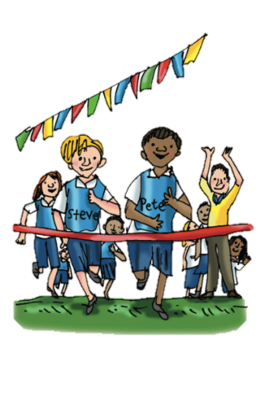
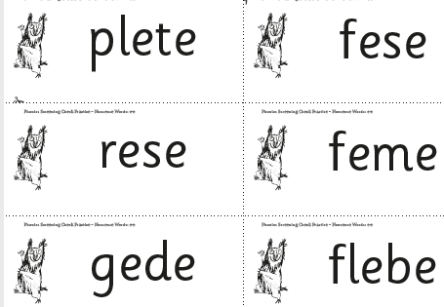
Phonics Homework
Please practice saying the sound and reading the real and alien words. Ask your child to look for ‘special friends’ and to ‘Fred Talk’
Real Words
theme
eve
swede
these
Go Pete and Steve
Alien Words

Slide 22
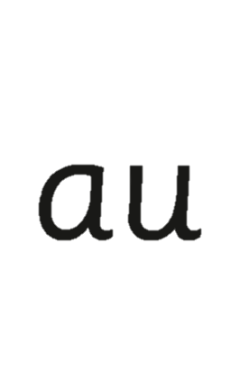

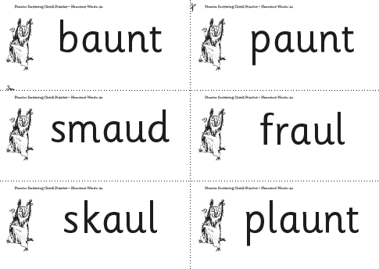
Phonics Homework
Please practice saying the sound and reading the real and alien words. Ask your child to look for ‘special friends’ and to ‘Fred Talk’
Real Words
haul
launch
fraud
taunt
Paul the astronaut
Alien Words

Slide 23
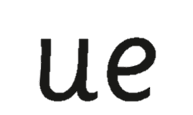

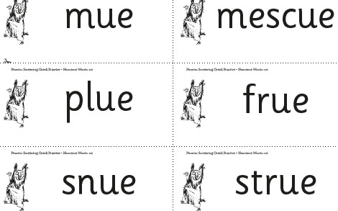
Phonics Homework
Please practice saying the sound and reading the real and alien words. Ask your child to look for ‘special friends’ and to ‘Fred Talk’
Real Words
glue
true
blue
clue
Come to the rescue!
Alien Words

Slide 24
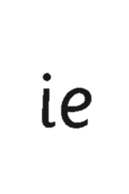
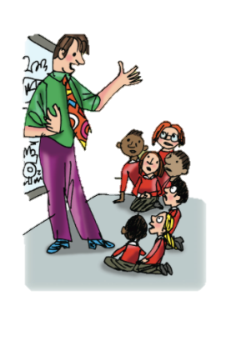
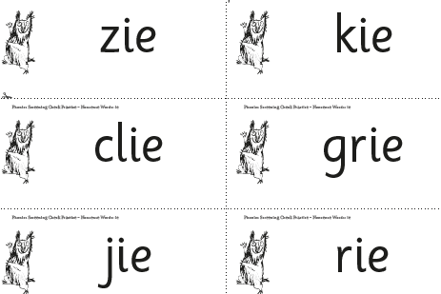
Phonics Homework
Please practice saying the sound and reading the real and alien words. Ask your child to look for ‘special friends’ and to ‘Fred Talk’
Real Words
tie
pie
tried
spied
Terrible tie
Alien Words

